Slide 1
Schematron + XSpec Automated testing for Schematron
Presented at JATS-Con 2017
Vincent Lizzi

Slide 2

Schematron
Schematron is a rule-based validation language that uses XPath expressions to test XML. Schematron is capable of expressing constraints that other languages such as DTD, XML Schema, and RelaxNG cannot validate.
https://github.com/Schematron/schematron

Slide 3

XSpec
XSpec is a unit test and Behaviour Driven Development (BDD) framework for XSLT and XQuery
and Schematron
https://github.com/xspec/xspec

Slide 4
Writing Schematron involves…
Get sample XML that contains both passing and failing conditions
Write XPath tests in Schematron
Test the Schematron using the sample XML
If modifying a Schematron, also have to…
Test to be sure nothing has broken existing parts of the Schematron
Running tests takes a lot of time!
XSpec can automate testing of Schematron

Slide 5
Schematron support in XSpec
New feature… may change!
Currently supports:
Test for <assert> and <report> thrown or not thrown
Test for specific assert and report using @id, @role, and @location
Test that a sample XML passes all validations
Sample XML can be given as complete files or inline fragments
Schematron phases
Scenarios can be imported from separate XSpec files
Test custom XSLT functions that are embedded in Schematron

Slide 6
XSpec Test Definition for Schematron
<description> is root element for XSpec test definition.
Path to Schematron file to be tested in @schematron
If needed, the Schematron phase to test is set using <param>

Slide 7
XSpec Test Definition for Schematron
Test scenarios are described using <scenario> elements.
Each scenario has a label that describes it in human readable terms.
<description> can include many test scenarios. Scenarios can be nested, and scenarios can be imported from separate XSpec files.

Slide 8

XSpec Test Definition for Schematron
Sample XML for the scenario is provided using <context> element.
Sample XML can be provided in a separate file that is specified by an href attribute.
Sample XML can be given as an XML fragment within the <context> element.

Slide 9

XSpec Test Definition for Schematron
For a scenario with sample XML that should pass all validations, the expected result is described by a <expect-valid> element.
Tests that the sample XML passes all validation rules in the Schematron.
Validation rules that have @role specifying warning or information may be thrown but still pass validation.

Slide 10
XSpec Test Definition for Schematron
For scenario testing that an <assert> is thrown the expected result is described by <expect-assert> element.
For scenario testing that an <report> is thrown the expected result is described by <expect-report> element.
For scenario testing that an <assert> is not thrown the expected result is described by <expect-not-assert> element.
For scenario testing that an <report> is not thrown the expected result is described by <expect-not-report> element.
<x:expect-assert/>
<x:expect-report/>
<x:expect-not-assert/>
<x:expect-not-report/>

Slide 11
XSpec Test Definition for Schematron
Specific expectations can be described by adding attributes to <expect-assert>, <expect-report>, <expect-not-assert>, and <expect-not-report> elements. These attributes can be used in any combination.
id – Specific <assert> or <report> using its id attribute or the id of the parent <rule>.
role – Match the role attribute value on a <assert>, <report> or <rule> for error, fatal, warn, info
location – Specific XPath location in the sample XML where an <assert> or <report> is expected to be thrown.

Slide 12
Example Scenario
Sample XML should pass validation but have a warning on the title element of the second section.
<x:scenario label="valid with warning on sec[2] title"> <x:context href="sample.xml"/> <x:expect-valid/> <x:expect-assert role="warn" location="/article[1]/body[1]/sec[2]/title[1]"/> </x:scenario>

Slide 13
Example Scenario
<assert id="a001"> should enforce rule that mixed-citation is required to have a publication-type attribute.
<x:scenario label="mixed-citation should have publication-type attribute"> <x:scenario label="Go"> <x:context> <mixed-citation publication-type="journal"/> </x:context> <x:expect-not-assert id="a001"/> </x:scenario> <x:scenario label="NoGo"> <x:context> <mixed-citation/> </x:context> <x:expect-assert id="a001"/> </x:scenario> </x:scenario>

Slide 14
Run XSpec Schematron Test
On Windows:
xspec.bat -s path\to\tests.xspec
On Linux:
xspec.sh -s path/to/tests.xspec

Slide 15
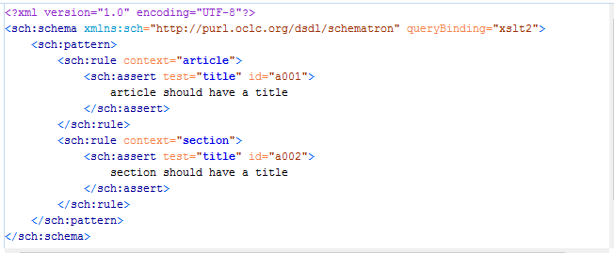
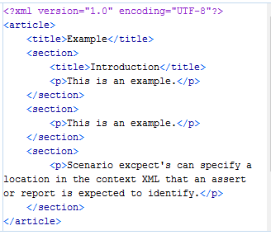
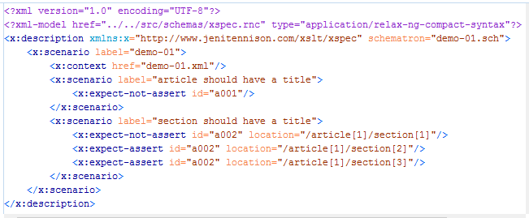
Semi-Live Demo
Schematron
Sample XML
XSpec

Slide 16
Quick start on Windows
Begin with Java and Git installed. Java https://java.com/en/download Git https://git-scm.com/download/win
Open a PowerShell prompt, and then enter this sequence of commands:
mkdir C:\Programs\xspec
cd C:\Programs\xspec
git clone https://github.com/xspec/xspec.git .
git fetch origin pull/105/head:schematron
git checkout schematron
Invoke-WebRequest -Uri http://central.maven.org/maven2/net/sf/saxon/Saxon-HE/9.7.0-15/Saxon-HE-9.7.0-15.jar -OutFile Saxon-HE-9.7.0-15.jar
Set-Item Env:SAXON_CP "C:\Programs\xspec\Saxon-HE-9.7.0-15.jar"
.\bin\xspec.bat -s .\tutorial\schematron\demo-01.xspec
Invoke-Item "C:\Programs\xspec\tutorial\schematron\xspec\demo-01-result.html"
Create folder
Download XSpec
Download pull
request 105*
Download
Saxon jar
Tell XSpec where
to find Saxon
Run XSpec demo
View the report
* For now until feature is released

Slide 17
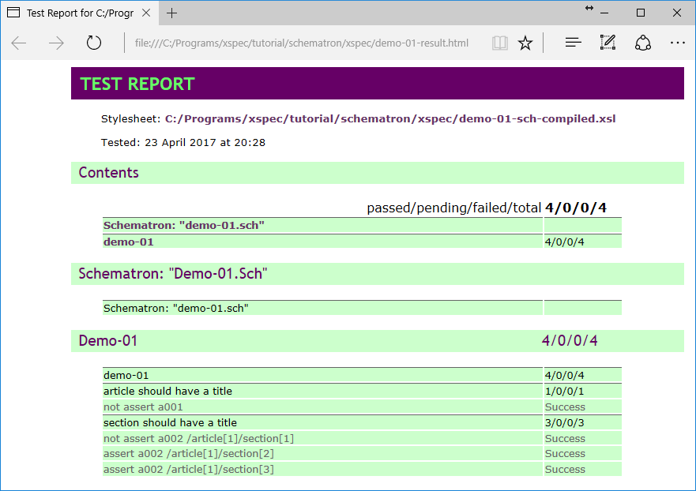
Test Report

Slide 18
XSpec Schematron Testing
Documentation and demo files:
https://github.com/vincentml/xspec/tree/schematron/tutorial/schematron
XSpec Issue #75 Schematron support: https://github.com/xspec/xspec/issues/75
E-mail Contact:
Vincent Lizzi
vincent.lizzi@taylorandfrancis.com

